Slide 1

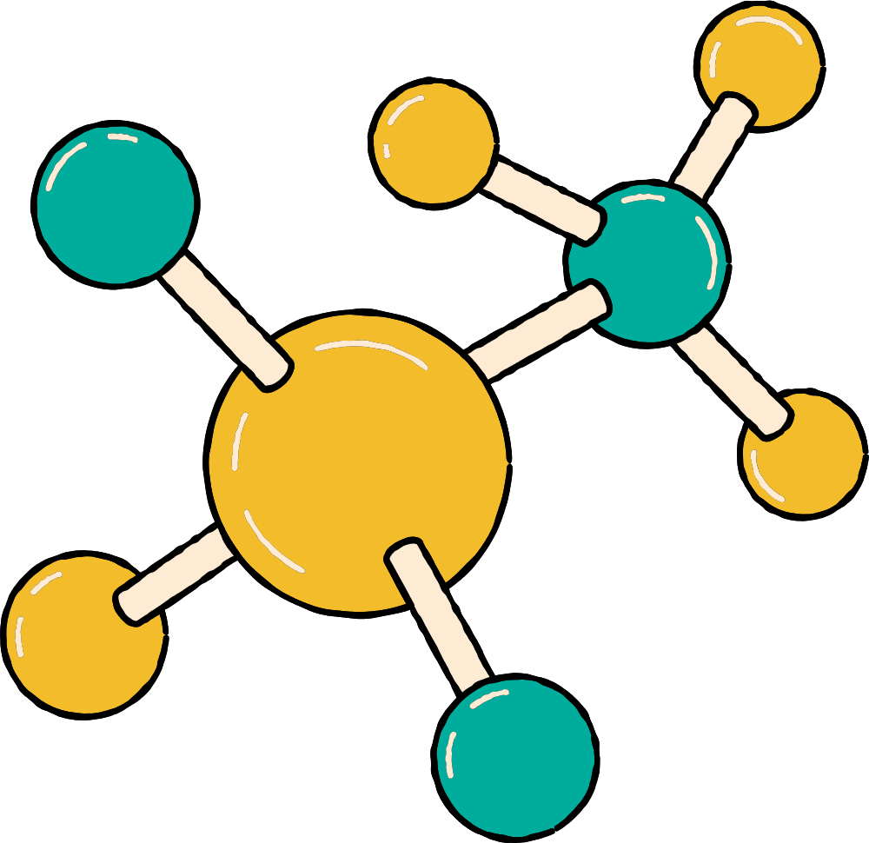
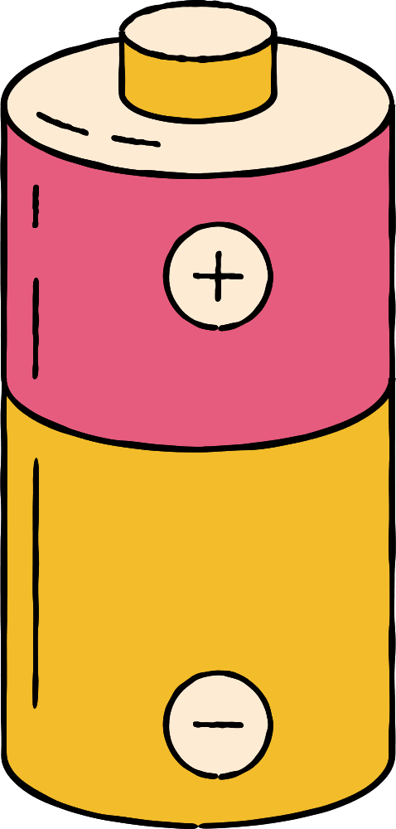



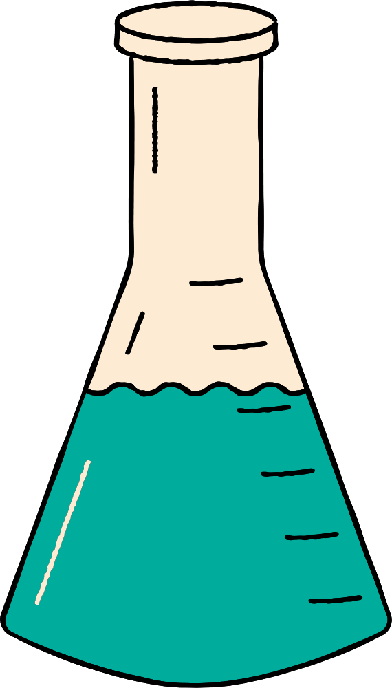








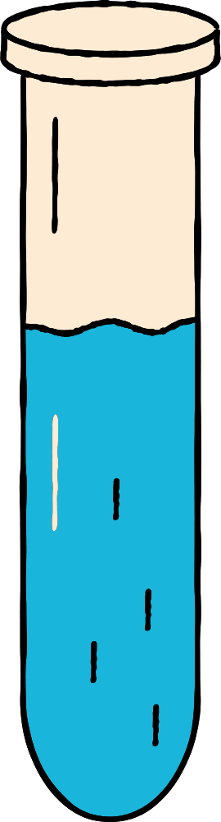
THE SCIENCE OF INTERMOLECULAR FORCES AND SUBSTANCE PROPERTIES
JONATHAN & KIM

Slide 2

WHAT IS INTERMOLECULAR FORCES?
Intermolecular forces are attractive forces between molecules.
They are weaker than chemical bonds, but they help determine a substance’s boiling point, melting point, shape, and physical state (solid, liquid, or gas).
In simple terms: intermolecular forces are the forces that hold molecules together and affect how they behave.

Slide 3
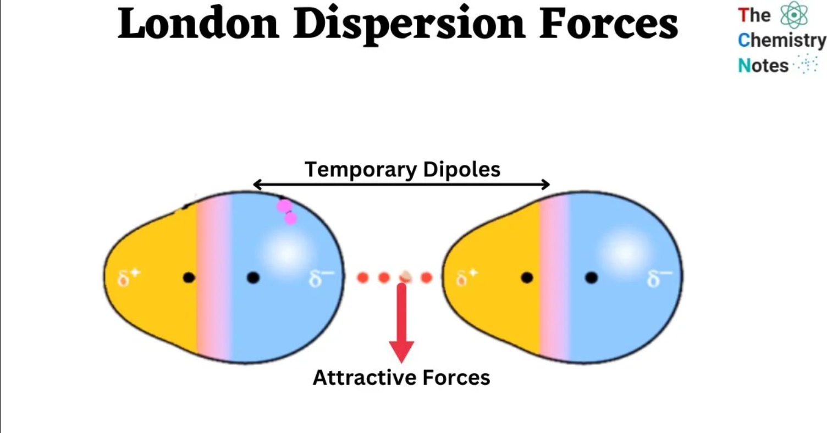
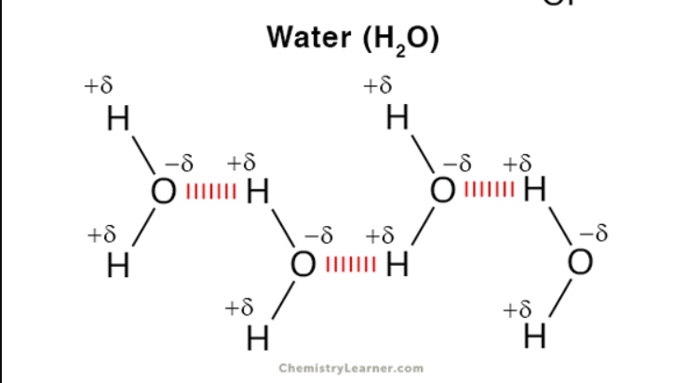
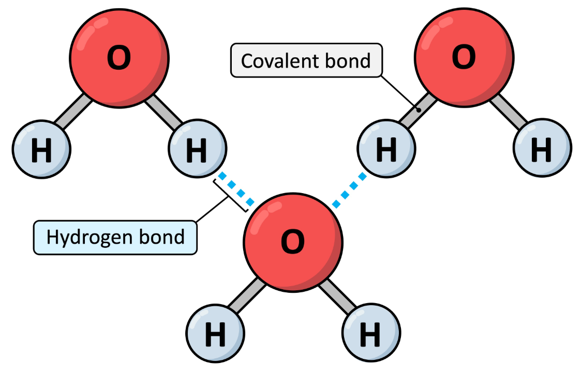
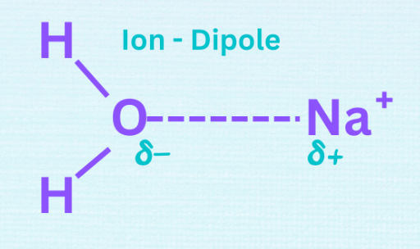
LONDON DISPERSION FORCES
2. DIPOLE–DIPOLE FORCES
3. HYDROGEN BONDING
4. ION–DIPOLE FORCES

Slide 4



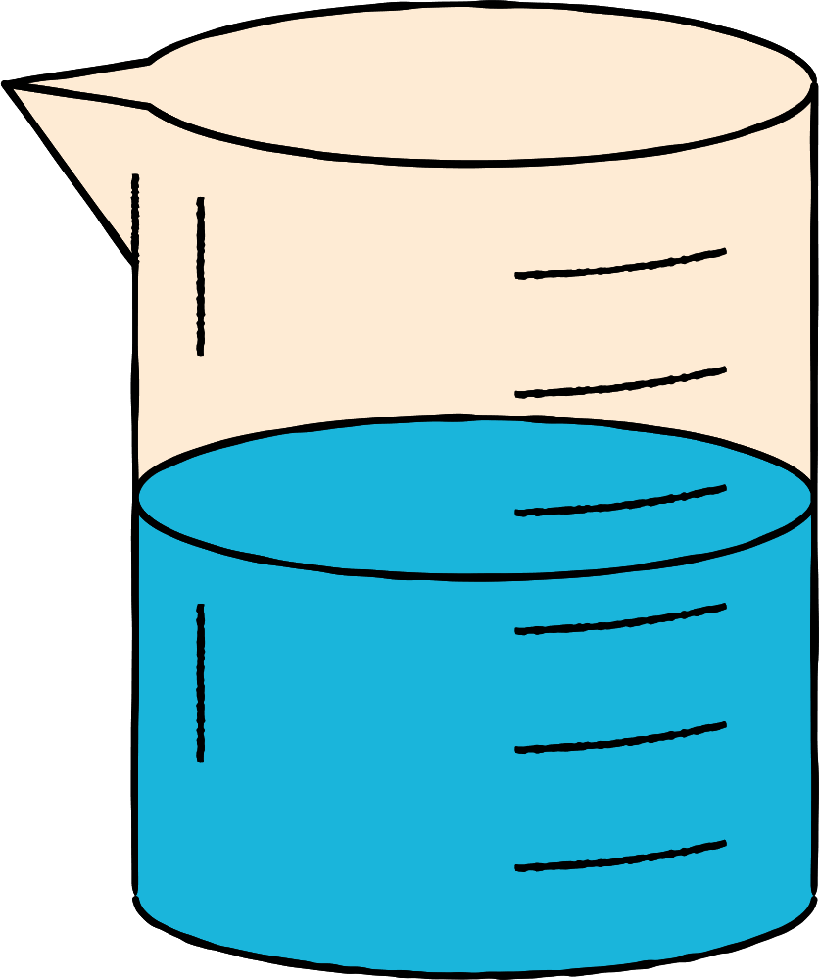

TYPES OF INTEMOLECULAR FORCES
LONDON DISPERSION FORCES
London Dispersion Forces are weak attractions found in all molecules. They happen when electrons briefly shift to one side, creating a temporary dipole that attracts nearby molecules. These forces get stronger in larger or heavier molecules.
Examples:
Nonpolar molecules like O₂ (oxygen) and N₂ (nitrogen) being able to liquefy because of temporary dipoles.
Noble gases like helium (He) and argon (Ar) condensing into liquids at very low temperatures.

Slide 5
TYPES OF INTEMOLECULAR FORCES
2. DIPOLE–DIPOLE FORCES
Dipole–Dipole Forces are attractions between polar molecules. Because these molecules have a positive end and a negative end, they naturally line up so opposite charges attract. These forces are stronger than London Dispersion Forces but weaker than hydrogen bonding.
Examples:
HCl (hydrogen chloride) – the positive H attracts the negative Cl of a neighboring molecule.
SO₂ (sulfur dioxide) – polar molecule with bent shape, creating attractions between molecules.

Slide 6
TYPES OF INTEMOLECULAR FORCES
3. HYDROGEN BONDING
Hydrogen Bonding is a strong type of intermolecular force that happens when hydrogen is bonded to very electronegative atoms like nitrogen (N), oxygen (O), or fluorine (F). The hydrogen becomes highly positive and strongly attracts nearby molecules’ negative ends. This force is stronger than dipole–dipole interactions and gives water many of its unique properties.
Examples:
H₂O (water) – hydrogen bonds between H and O give water its high boiling point.
NH₃ (ammonia) – H bonds form between H and N atoms of neighboring molecules.

Slide 7
TYPES OF INTEMOLECULAR FORCES
4. ION–DIPOLE FORCES
Ion–Dipole Forces are attractions between an ion (a charged particle) and a polar molecule. They are quite strong because the full charge of the ion is pulled toward the partial charge of the polar molecule. This force is important in processes like dissolving salt in water.
Examples:
Na⁺ in water – the positive sodium ion is attracted to the negative oxygen of water molecules.
Cl⁻ in water – the negative chloride ion is attracted to the positive hydrogen of water molecules.

Slide 8
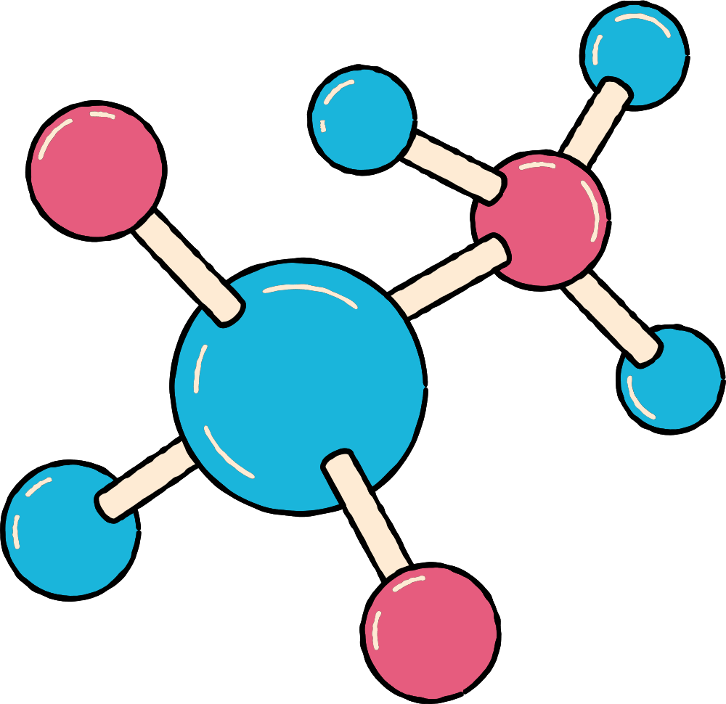
EFFECTS OF INTERMOLECULAR FORCES ON BOILING POINT
The stronger the intermolecular forces, the higher the boiling point of a substance. This is because more energy is needed to overcome the attractions between molecules.
For example:
Substances with hydrogen bonding (like H₂O) have higher boiling points than similar-sized molecules with only London Dispersion Forces.
Dipole–dipole interactions increase boiling points compared to nonpolar molecules.
London Dispersion Forces can raise boiling points in larger molecules with more electrons.
In short, stronger forces = higher boiling point; weaker forces = lower boiling point.

Slide 9
EFFECTS OF INTERMOLECULAR FORCES ON MELTING
The stronger the intermolecular forces, the higher the melting point of a substance. Strong attractions between molecules make it harder for them to move past each other and change from solid to liquid.
Ionic compounds and substances with hydrogen bonding usually have high melting points.
Nonpolar molecules with only London Dispersion Forces tend to have lower melting points.
In short, stronger forces = higher melting point; weaker forces = lower melting point.

Slide 10
EFFECTS OF INTERMOLECULAR FORCES ON SOLUBILITY
The type and strength of intermolecular forces determine how well a substance dissolves. “Like dissolves like”—polar substances dissolve in polar solvents, and nonpolar substances dissolve in nonpolar solvents.
Polar molecules with dipole–dipole or hydrogen bonding dissolve well in polar solvents like water.
Nonpolar molecules with London Dispersion Forces dissolve better in nonpolar solvents like hexane.
Stronger intermolecular attractions between solute and solvent increase solubility.

Slide 11
EFFECTS OF INTERMOLECULAR FORCES ON EFFECTS ON VISCOSITY & SURFACE TENSION
Viscosity: Stronger intermolecular forces make molecules resist flow, increasing viscosity. For example, liquids with hydrogen bonding, like honey, are more viscous than water.
Surface Tension: Strong forces pull surface molecules inward, raising surface tension. Water has high surface tension due to hydrogen bonds between molecules.

Slide 12


CONCLUSION
Intermolecular forces are attractions between molecules that affect properties like boiling/melting points, viscosity, surface tension, and solubility. Stronger forces mean higher values. Main types are London Dispersion, Dipole–Dipole, Hydrogen Bonding, and Ion–Dipole. Understanding IMF explains how substances behave in different states and solutions.

Slide 13
REFERENCE
Brown, T. L., LeMay, H. E., Bursten, B. E., Murphy, C., & Woodward, P. (2018). Chemistry: The central science (14th ed.). Pearson.
— Source for definitions of intermolecular forces, boiling/melting point trends, and examples.
Zumdahl, S. S., & Zumdahl, S. A. (2020). Chemistry (11th ed.). Cengage Learning.
— Source for London Dispersion, Dipole–Dipole, Hydrogen Bonding, and Ion–Dipole descriptions.
Atkins, P., Jones, L., & Laverman, L. (2017). Chemical principles: The quest for insight (7th ed.). W. H. Freeman.
— Source for polarity, molecular interactions, and dissolution (“like dissolves like”).

Slide 14
Quiz time
1. Which force is the weakest? a) Hydrogen bonding b) Ion-dipole c) London dispersion d) Dipole-dipole
2. Hydrogen bonding happens when H is bonded to: a) O, N, or F b) C, O, or N c) O, F, or Cl d) H, C, or N
3. Stronger intermolecular forces usually mean: a) Lower boiling point b) Higher boiling point c) Lower melting point d) Less sticky liquids
4. Which force is in all molecules? a) Ion-dipole b) London dispersion c) Dipole-dipole d) Hydrogen bonding
5. Which property depends on intermolecular forces? a) Atomic number b) Boiling point c) Electron number d) Nuclear stability

Slide 15
Quiz time
6. Which has hydrogen bonding? a) H₂ b) CH₄ c) H₂O d) Cl₂
7. A polar molecule with strong forces will: a) Evaporate fast b) Have high boiling point c) Not dissolve in water d) Flow easily
8. Ion-dipole forces happen when: a) Salt dissolves in water b) Gas is cooled c) Methane is liquid d) Metal melts
9. London forces get stronger if: a) Molecule is bigger b) Molecule is smaller c) Molecule is polar d) Molecule has H-bond
10. Which has the highest boiling point? a) CH₄ b) NH₃ c) H₂S d) HCl

Slide 16


THANK YOU

